Slide 1
Capstone Project - 4
NETFLIX MOVIES AND TV SHOWS CLUSTERING
Team Members
SAAQUIB MUSTAFA
SAHIL KOLAMBKAR

Slide 2
APPROACH OVERVIEW
Exploratory Data Analysis
Data
Data Cleaning
Introduction Objective
Acquisition
Netﬂix Movies & TV Shows Clustering and the objectives of this project
Problem statement
Problem Objective
Dataset description
Attributes
Handling Null Values.
Clean data to get it ready for analysis.
Exam data with visualizations.
Verify ﬁndings with statistical test.
Text Features-Clustering
Clustering
Dimensionality Reduction
Conclusion
Text
Pre-Processing
Vectorization
TF-IDF
Finding Optimal K
K-Means clustering with optimal K
PCA
Most common words in each cluster
Future work

Slide 3


Netﬂix is a streaming service that offers a wide variety of award-winning TV shows, movies, anime, documentaries and more – on thousands of internet-connected devices. You can watch as much as you want, whenever you want, without a single ad, in one simple subscription. There's always something new to discover, and new TV shows and movies are added every week! Streaming in more than 30 languages and 190 countries.

Slide 4

PROBLEM STATEMENT & OBJECTIVE
Exploratory Data Analysis.
Understanding what type content is available in different countries.
Is Netﬂix has increasingly focusing on TV rather than movies in recent years?
Clustering similar content by matching text-based features.

Slide 5


DATA DESCRIPTION
The data was collected from Flixable (third party Netﬂix search engine)
7787 Rows of data
Movies & TV Dataset till 2019
Dataset consists of Eleven categorical columns and One numerical column.

Slide 6
ATTRIBUTES
Show_id
Type
Title
Director
Cast
Country
Date_added
Release_Year
Rating
Duration
Listed_in
Description
Unique ID for every Movie / Tv Show
Identiﬁer - A Movie or TV Show
Title of the Movie / Tv Show
Director of the Movie
Actors involved in the movie / show
Country where the movie / show was produced
Date it was added on Netﬂix
Actual Release year of the movie / show
TV Rating of the movie / show
Total Duration - in minutes or number of seasons
Genre
The Summary description
12

Slide 7

DATA CLEANING
★ Handling Comma & De-limited Values
★ Movies are based on the duration of the movie and shows are based on the number of seasons. To make EDA easier, convert the values in these columns into integers for both the movies and shows datasets.
★ Removing unnecessary columns like director, cast.
★ Dropping all NAN values containing date_addded observations.
★ Created 4 new columns :
No. of categories based on listed_in.
Date_added_month based on date_added
★ Handling Null Values - There are a total of 3,631 null values across the entire dataset with missing points under 'director', 'cast', 'country', 'date_added', and 'rating'.
There are 2389 null values in the Director column.
There are 718 null values in the cast column.
There are 507 null values in the country column.
There are 10 null values in the date added column.
There are 7 null values in the rating column.

Slide 8


EXPLORATORY DATA ANALYSIS

Slide 9
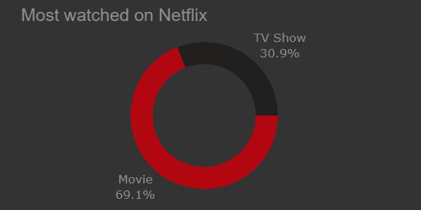
TV SHOWS OR MOVIES?
There are 5,372 movies and 2,398 TV shows. There are far more movie titles (69.1%) that TV shows titles (30.9%) in terms of title.

Slide 10
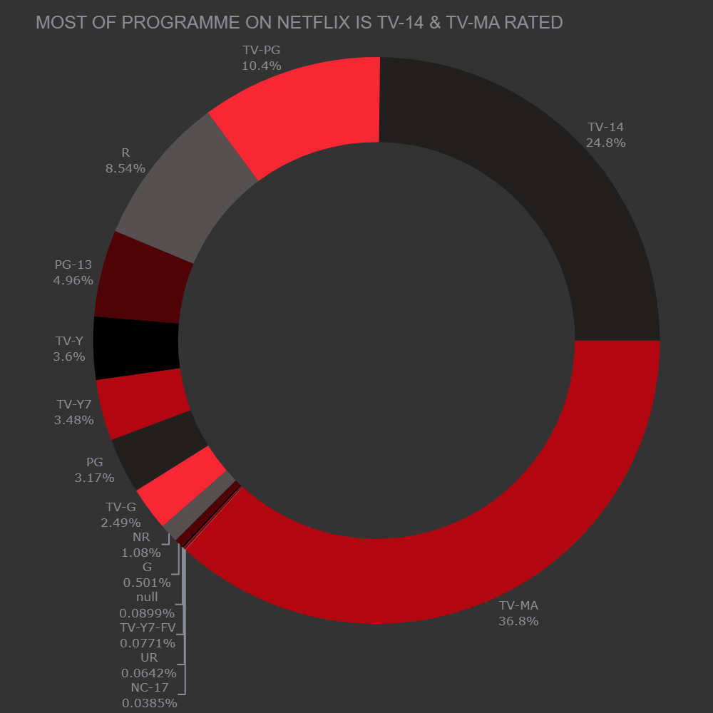
RATINGS ON NETFLIX
The largest count of Netﬂix content is made with a “TV-14” rating. But the largest count of TV shows is made with a “TV-MA” rating(“TV-MA” is a rating assigned by the TV Parental Guidelines to a television program designed for mature audiences only).

Slide 11
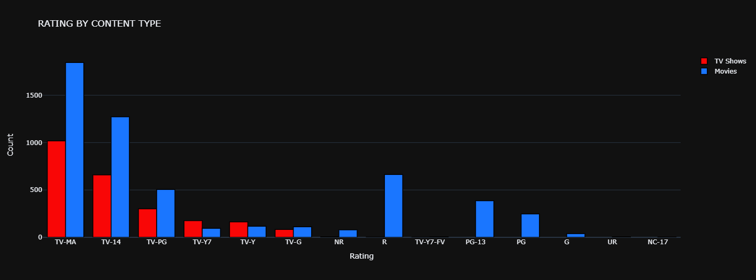
RATING ANALYSIS ON NETFLIX TITLES BY TYPE
Mature audiences have more Movies content whereas younger(below 17 age) have more TV Shows content.

Slide 12
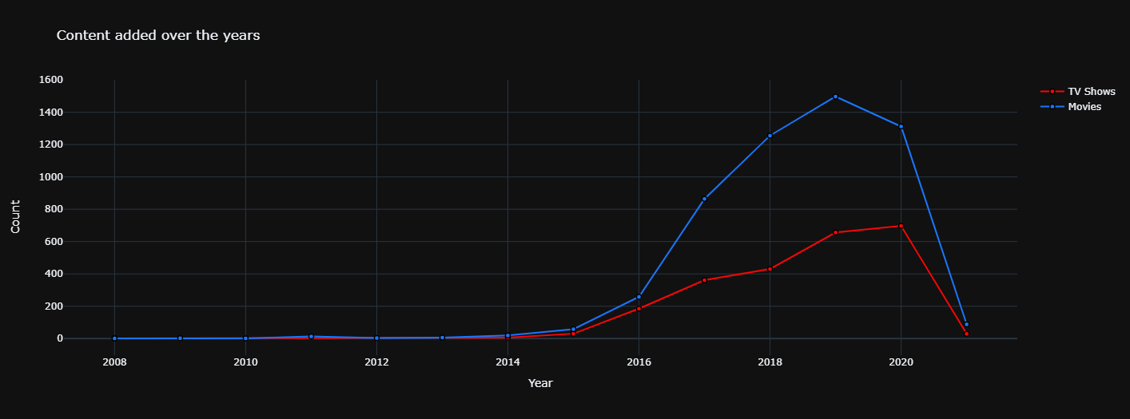
CONTENT ADDED EACH YEARLY, MONTHLY
The popular streaming platform started gaining traction after 2014.
There has been a consistent growth in the number of movies on Netﬂix compared to shows.

Slide 13
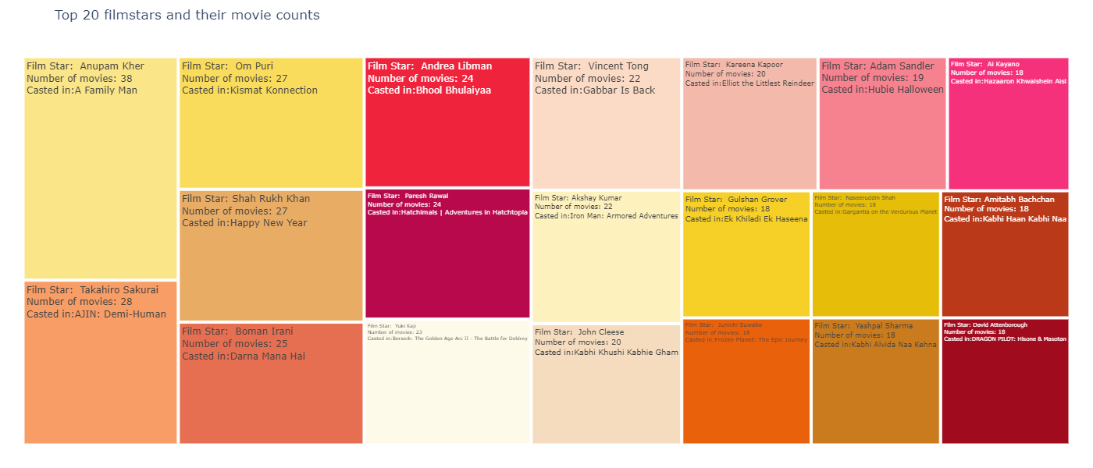
TREEMAP OF TOP 20 FILMSTARS AND THEIR MOVIE COUNTS

Slide 14
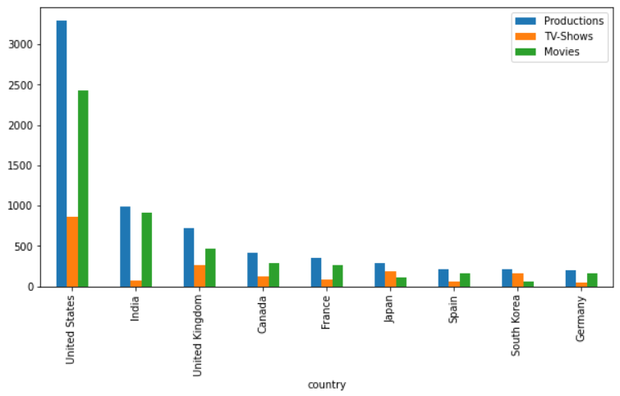
COUNTRIES WITH MOST CONTENT AVAILABLE
The United States stands out on top. India surprisingly comes in second followed by the UK and Canada. China interestingly is not even close to the top even though it has about 18% of the world's population.

Slide 15
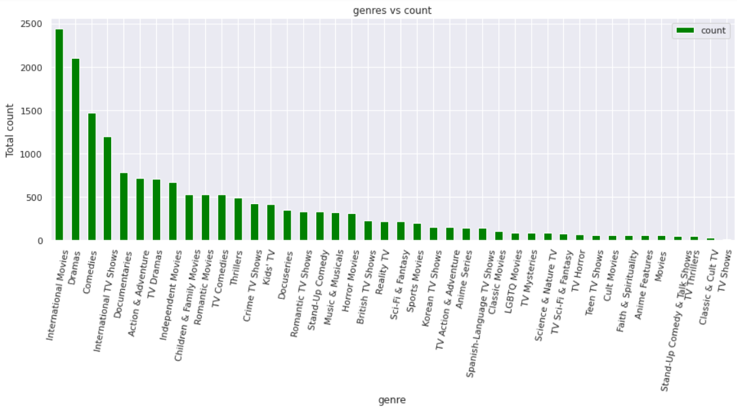
POPULAR GENRES
International Movies takes the cake surprisingly followed by Dramas and Comedies.

Slide 16
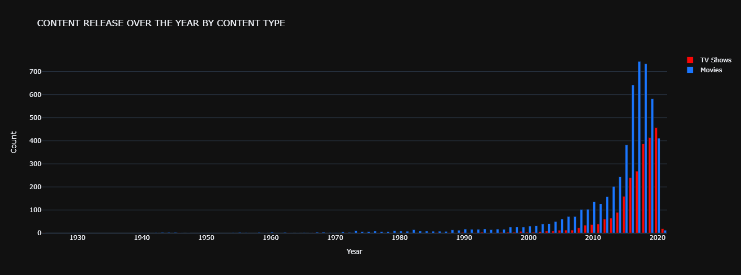
CONTENT RELEASED OVER THE YEAR BY CONTENT TYPE
Highest number of movies(744) got added in the year of 2017 and TV Shows(457) 2020

Slide 17
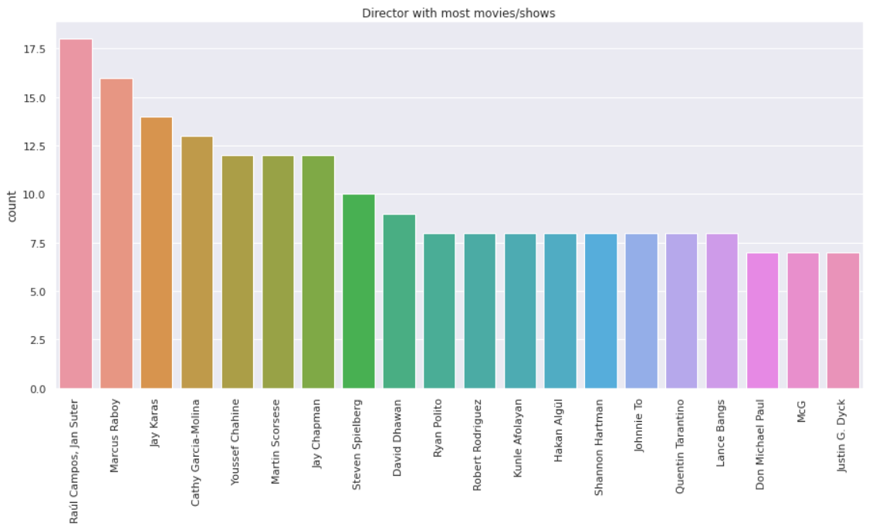
TOP 10 DIRECTORS ON NETFLIX WITH THE MOST RELEASES?
The most popular directors on Netﬂix with the most titles are mostly international.

Slide 18
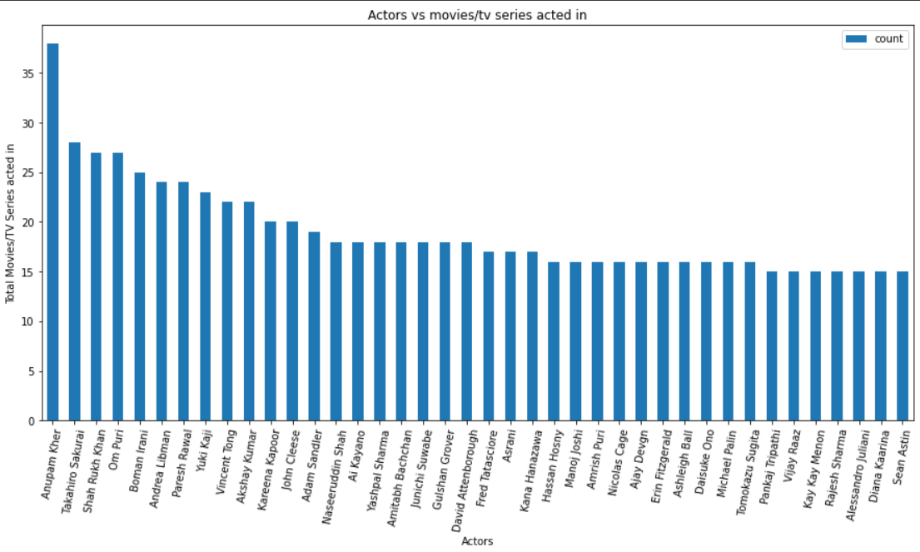
TOP ACTORS ON NETFLIX MOVIES BASED ON THE NUMBER OF TITLES
The majority of Netﬂix movies are starring Indian actors.

Slide 19


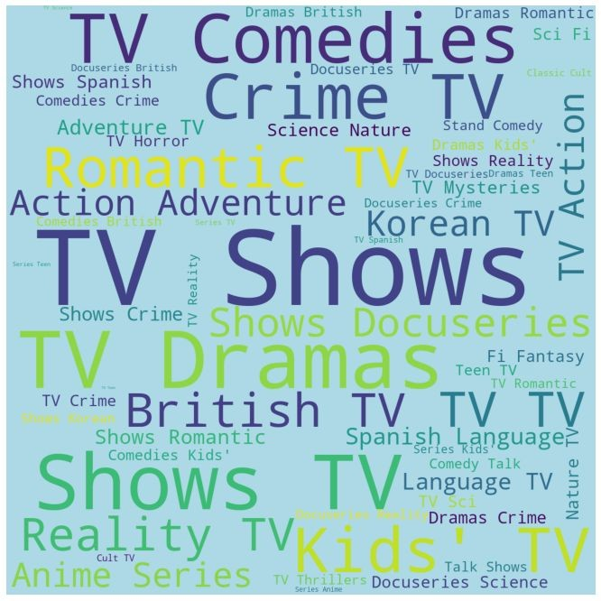

NETFLIX BY TITLES DESCRIPTION ON MOVIES: GENRES
NETFLIX BY TITLES DESCRIPTION ON TV SHOWS: GENRES
Word Cloud applied on Genres. Most present movies are Romantic, Dramas, Independent, Action, Adventure, Children, Family, Comedies.
Most present TV Shows are Comedies, crime, romantic, adventure, Korean, action, dramas, british tv, reality shows, Anime & kids.

Slide 20


CLUSTERING DATASET
TEXT FEATURES
Clustering similar content by matching text-based features

Slide 21



TEXT PRE-PROCESSING
1
Cleaned Null values
All columns - characters selected by regex
All words to lowercase
CLEANING
●
2
Removed stop words
Normal English words & problem speciﬁc
STOP WORDS
3
Splitted sentences to tokens
Used word_tokenise from NLTK
TOKENIZATION
4
Transformed words to roots
Used Word Net Lemmatizer
LEMMATIZER

Slide 22
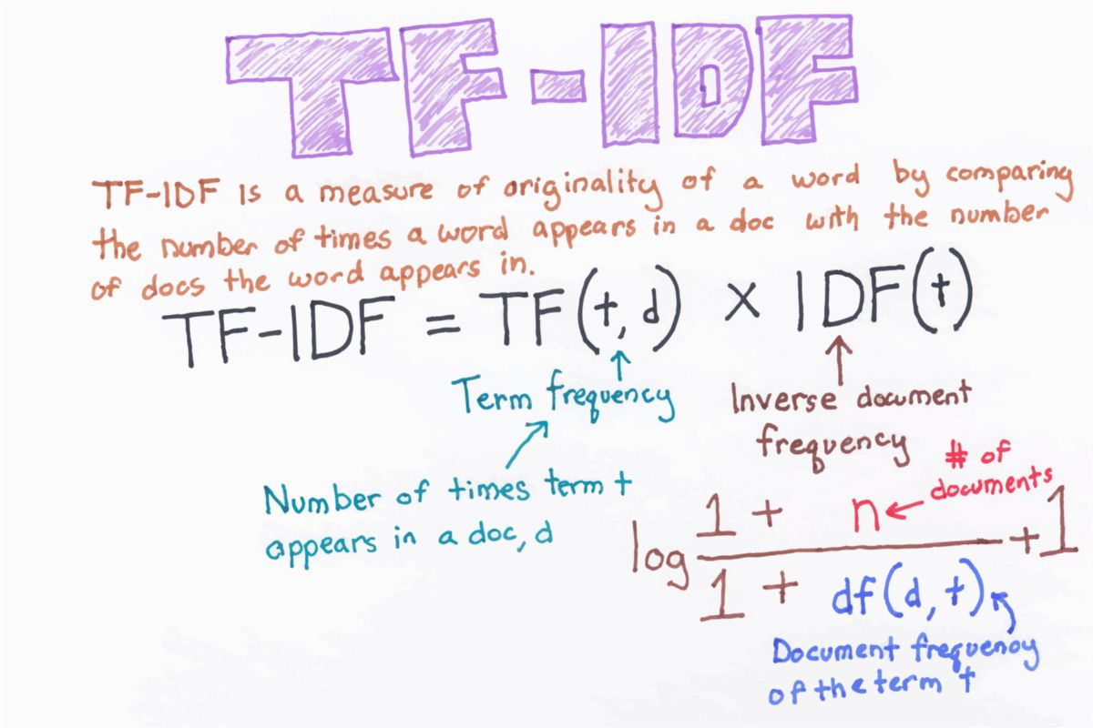
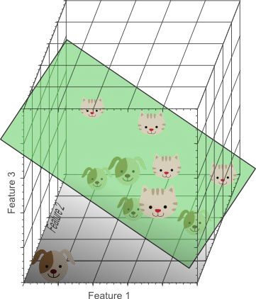
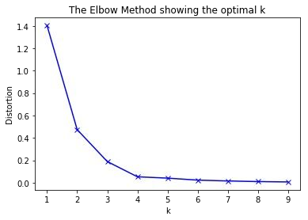

Data Preprocessing
TIME TO CLUSTER….
K-MEANS CLUSTERING WITH OPTIMAL K
VECTORIZATION
DIMENSIONALITY REDUCTION
FINDING OPTIMAL K
TF-IDF VECTORIZER
PCA
Silhouette score
Elbow method
What could we infer?

Slide 23
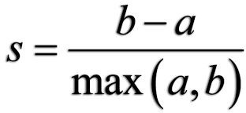
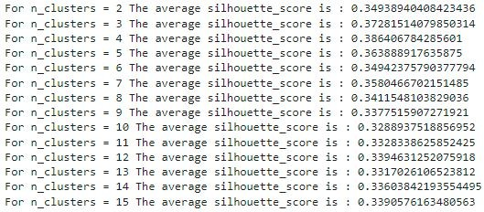
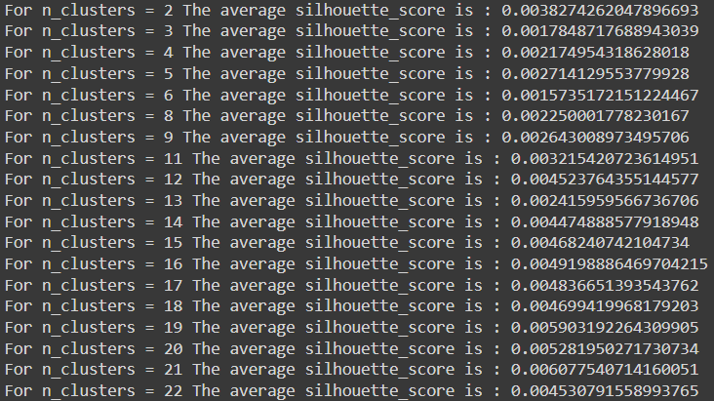
SILHOUETTE SCORE
The Silhouette Coefﬁcient formula is
Silhouette score method(in range clusters): Optimum score is 0.06 for n_clusters = 9.

Slide 24
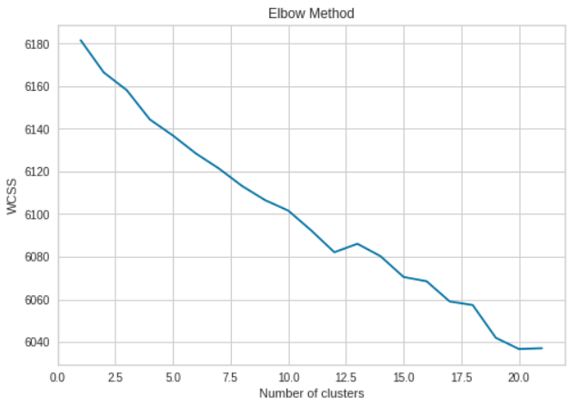
ELBOW METHOD
We can observe that the “elbow” is the number 9 which is optimal for this case. We can also verify this because there are 6 different genres so this result was pretty much expected.
Clustering is pretty accurate. Applying k-means clustering for K = 9

Slide 25
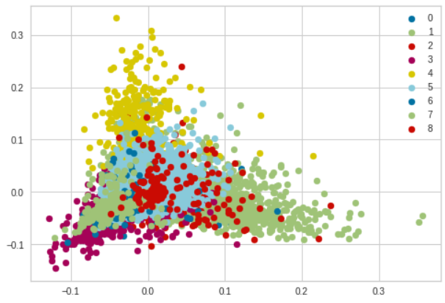
DIMENSIONALITY REDUCTION
After applying Principal Component Analysis(PCA) we have arrived with Silhouette score 0.344

Slide 26


FUTURE SCOPE!
Integrate Netﬂix dataset with other data set and present more insights and clusters.
We could have done some research on recommendation system.

Slide 27
CONCLUSION:
The ratio of Tv show and movie is 31% to 69% in most watched-on Netflix
Here, top 20 Directors with the greatest number of Movies/Shows on Netflix. Highest is Raul Campos and lowest is Justin G. Dyck
The most of movies acted by any actor is Anupam kher followed by Takahiro and Shahrukh khan
Highest number in production, Tv shows and movies is in USA country followed by India.
Most movies/tv show got released in 2018 and least 2006
More content with Mature content is available on Netflix.
Cluster value we got from knee elbow method is 9
Cluster 0: Dramas & International TV Shows
Cluster 1: Sc-Fi, Adventure and Action
Cluster 2: International Movies
Cluster 3: Comedy
Cluster 4: Romantic Movies
Cluster 5: Stand-Up Comedy
Cluster 6: Documentary
Cluster 7: International Movies
Cluster 8: Children and Family movies

Slide 28

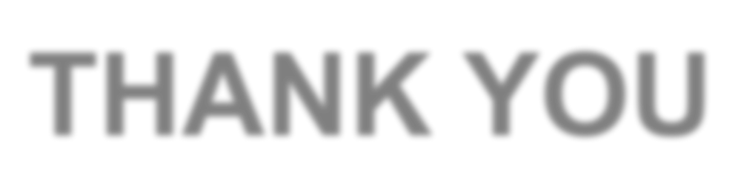
THANK YOU

